Slide 1
A* ALGORITHM IMPLEMENTATION IN PYTHON
ABID K. (12VL01F)
MUHAMMED ASIF KT.(12VL15F)
SREEJITH S.(12VL24F)

Slide 2
TOOLS USED
PYTHON
PYGAME FOR GUI
Pygame provides a set of useful graphics drawing functions, GUI facilities etc

Slide 3
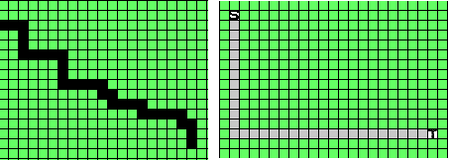
MODIFICATIONS
Better straight path & less number of cells processed
Original Algorithm :
next_cell = cell with minimum f_score in Open List
Modified Algorithm :
next_cell = cell with minimum h_score among cells with same minimum f_score in Open List

Slide 4
MULTILAYER IMPLEMENTATION
We implemented two layers.
Path goes to second layer only if no path found in first layer.

Slide 5
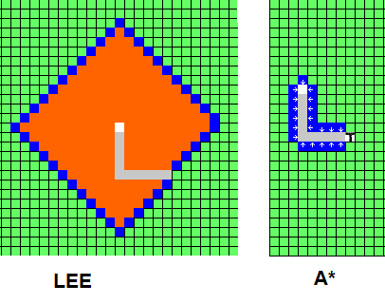
A* ALGORITHM v/s LEE ALGORITHM
A* processes considerably less number of cells

Slide 7
Merits & Demerits
Faster because less number of cells processed
Less flexibility compared to Lee algorithm
A* provides a single path in a run while Lee provides all possible paths. So Lee provides all kinds of customizations to be done during retrace phase.

Slide 8
FURTHER IMPROVEMENTS
If second layer provides a shorter path compared to first layer in presence of block, second layer can be considered.

Slide 9
THANK YOU

